Slide 1
Distributed OS

Slide 2
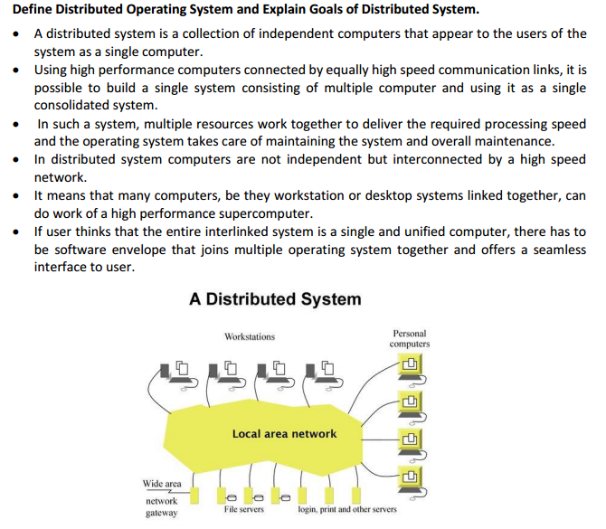

Slide 3
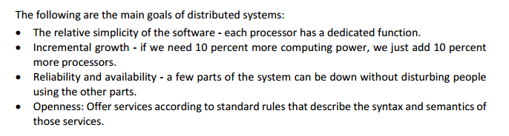

Slide 4
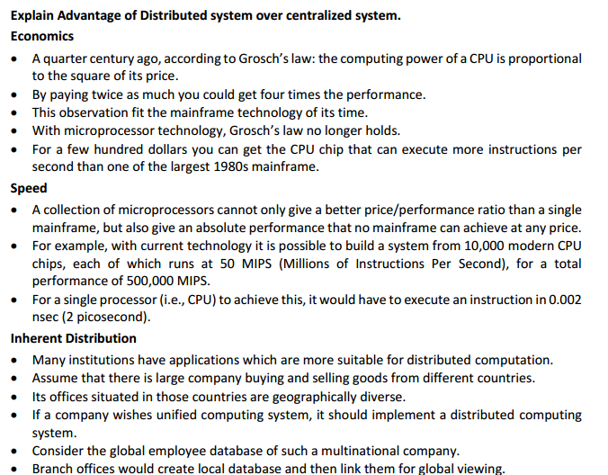
I

Slide 5
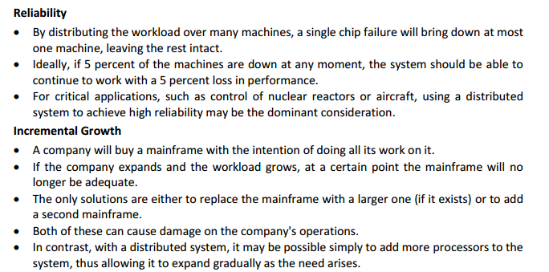
I

Slide 6
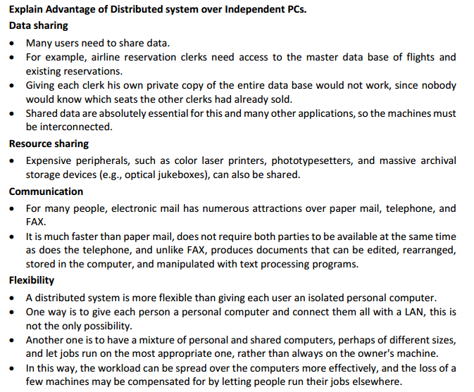
I

Slide 7
Disadvantages of Distributed System
Security problem due to sharing.
Some message can be lost in the network system.
Bandwidth is another problem if there is large data then all network wires to be replaced which tends to become expensive.
Overloading is another problem in distributed system.
If there is database connection on local system and many users accessing that database through remote or distributed way then performance become slow.

Slide 8
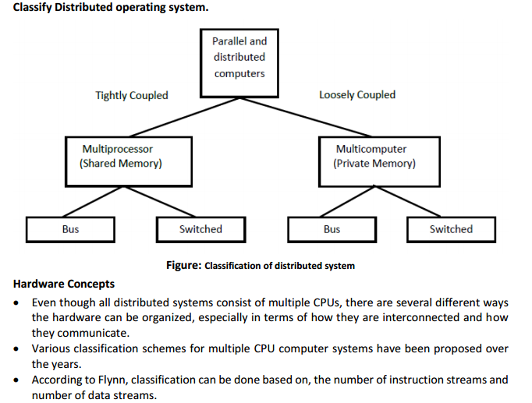
I

Slide 9
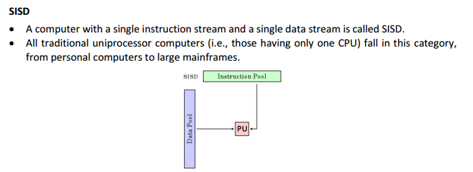
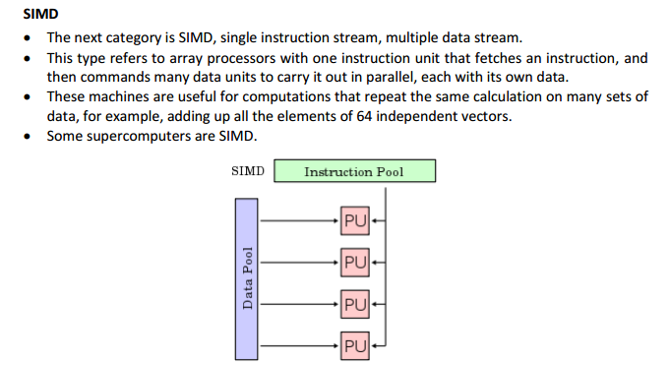
I

Slide 10
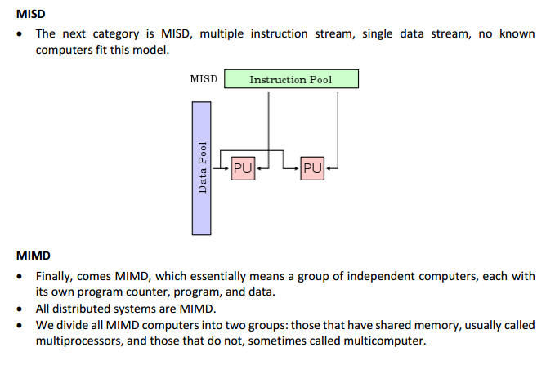
I

Slide 11
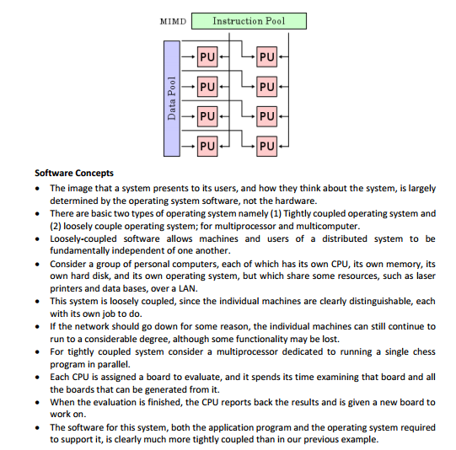
I

Slide 12
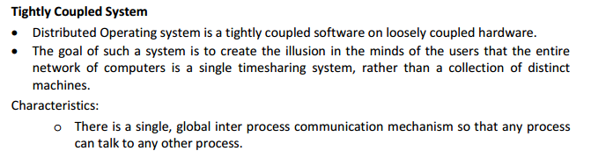
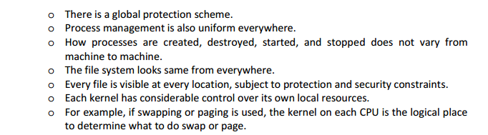

Slide 13
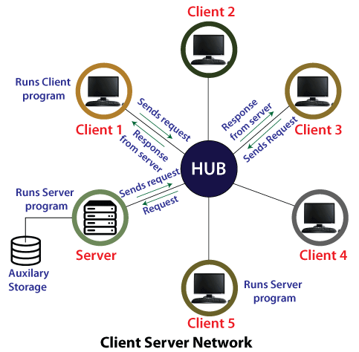
Network operating system
An Operating system, which includes software and associated protocols to communicate with other autonomous computers via a network conveniently and cost-effectively, is called Network Operating System. It allows devices like a disk, printers, etc., shared between computers.
Client-Server Network Operating System
In Client-Server systems, there are two broad categories of systems:
The server is called the backend.
A client called as frontend.

Slide 14
Network operating system
Advantages of Client-Server Network Operating System
The servers are highly stable and centralized
Servers handle security concerns
Up-gradation is easy
Disadvantages
Costly servers
Dependent on central location
Regular update and maintenance require

Slide 15
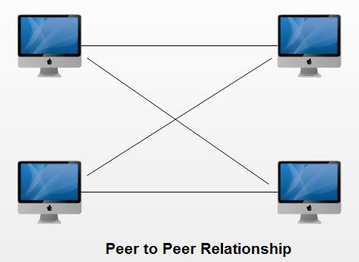
Network operating system
Peer-to-Peer Networks
In a peer to peer network each computer can not act as both a server and a client.

Slide 16
Network operating system
Advantages of Peer to Peer Networks
Peer to peer networks have following advantages
1. Such networks are easy to set up and maintain as each computer manages itself.
2. It eliminates extra cost required in setting up the server.
3. Since each device is master of its own, they an: not dependent on other computers for their operations.

Slide 17
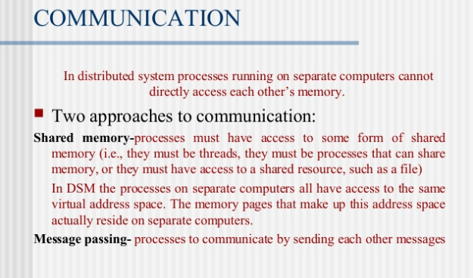
Communication in Distributed System

Slide 18
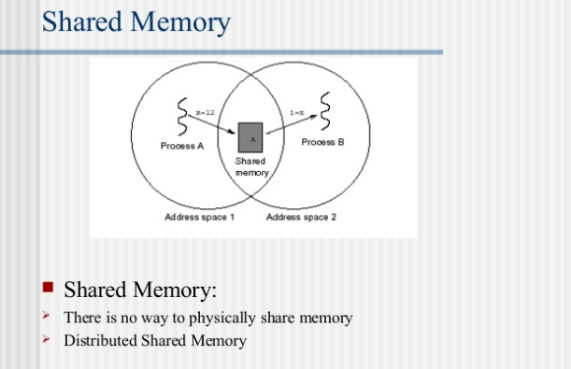
Communication in Distributed System

Slide 19
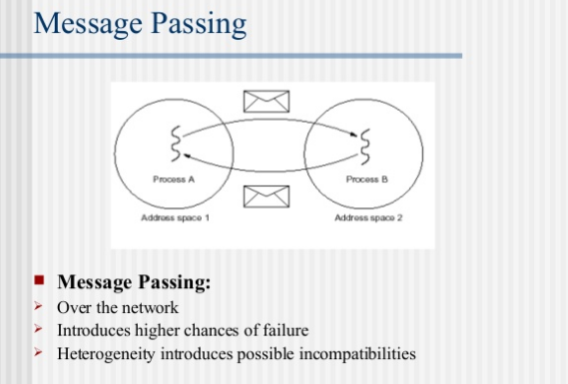
Communication in Distributed System

Slide 20
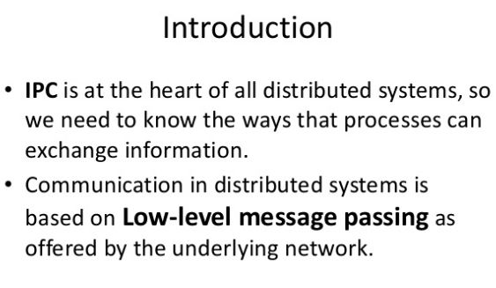
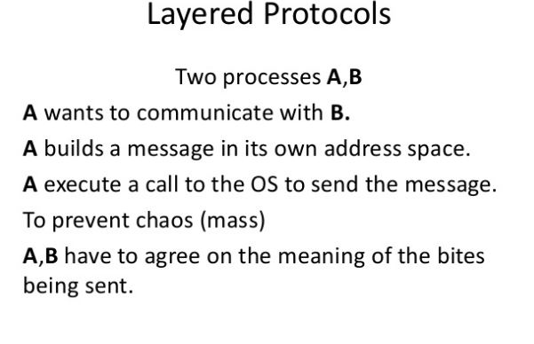
Communication in Distributed System IPC (Inter Processs Communication)

Slide 21
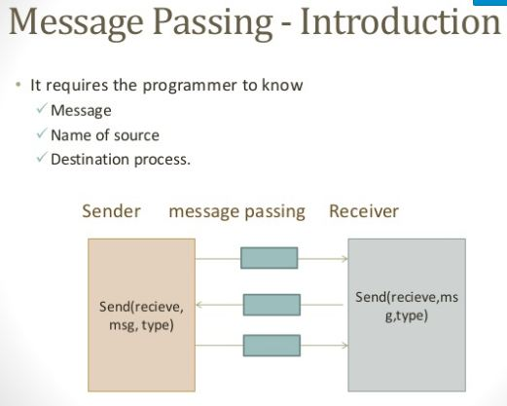

Slide 22
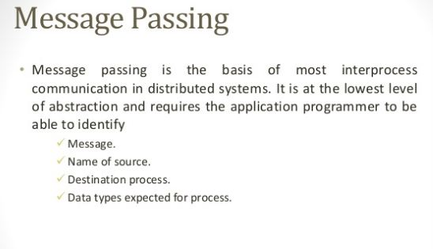

Slide 23


Slide 24


Slide 25
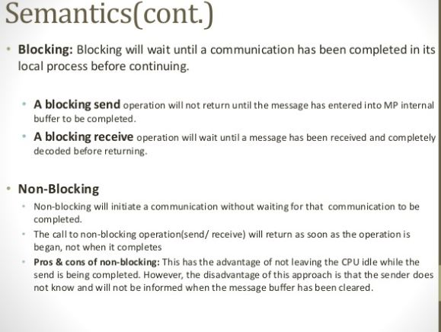

Slide 26
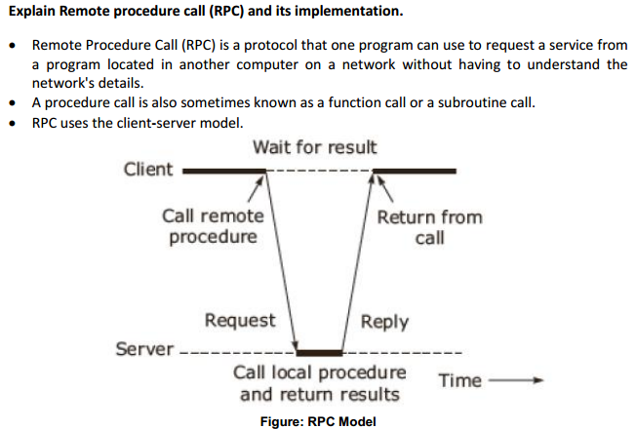

Slide 27
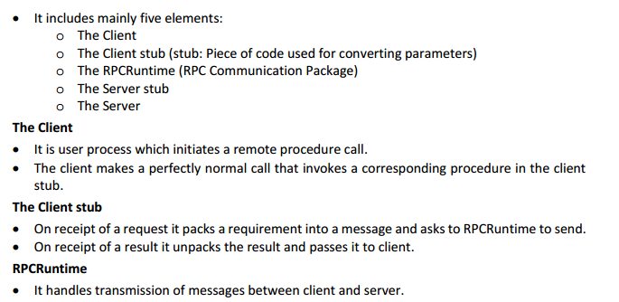

Slide 28
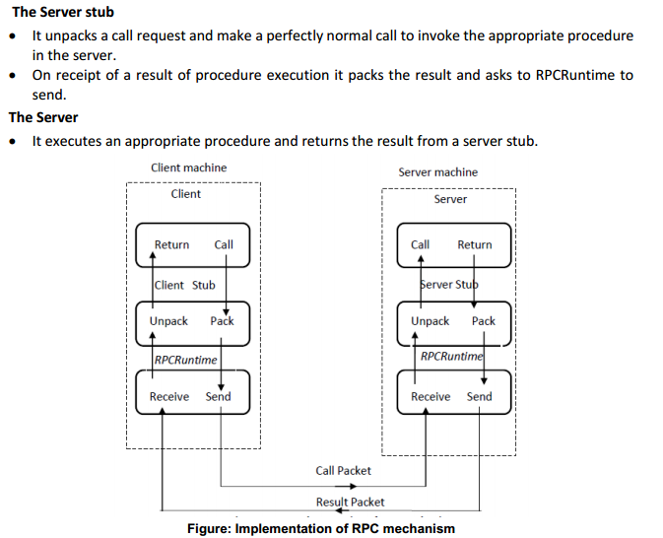

Slide 29
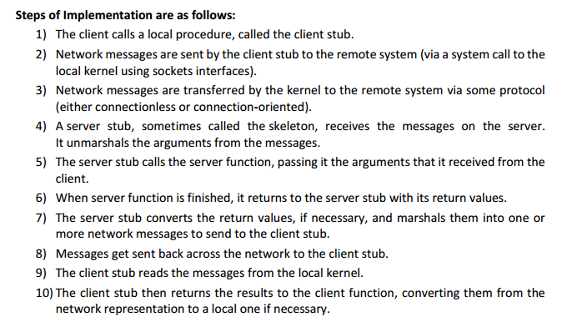

Slide 30
Clock Synchronization
Distributed System is a collection of computers connected via the high speed communication network. In the distributed system, the hardware and software components communicate and coordinate their actions by message passing. Each node in distributed systems can share their resources with other nodes. So, there is need of proper allocation of resources to preserve the state of resources and help coordinate between the several processes.
The clock synchronization can be achieved by 2 ways: External and Internal Clock Synchronization.
External clock synchronization is the one in which an external reference clock is present. It is used as a reference and the nodes in the system can set and adjust their time accordingly.
Internal clock synchronization is the one in which each node shares its time with other nodes and all the nodes set and adjust their times accordingly.

Slide 31
Clock Synchronization
Centralized is the one in which a time server is used as a reference. The single time server propagates its time to the nodes and all the nodes adjust the time accordingly. It is dependent on single time server so if that node fails, the whole system will lose synchronization. Examples of centralized are- Berkeley Algorithm, Passive Time Server, Active Time Server etc.
Distributed is the one in which there is no centralized time server present. Instead the nodes adjust their time by using their local time and then, taking the average of the differences of time with other nodes. Distributed algorithms overcome the issue of centralized algorithms like the scalability and single point failure.

